Slide 1
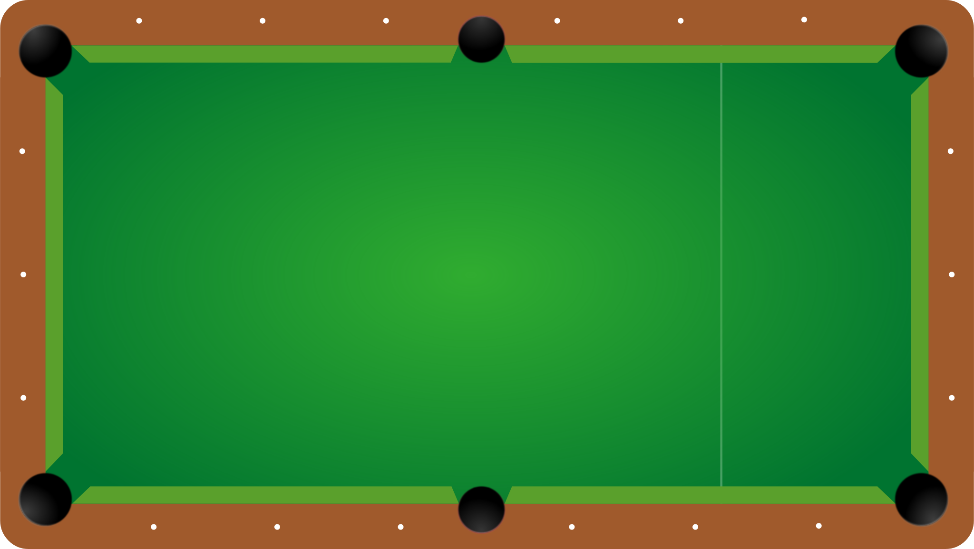

Team Indecisive Productivity
Cristina Bindschatel, Luke Jeries, Will Rieske, Taylor Shephard, Dan Wiseman

Slide 2
Overview
Scope
Technologies Used
Use Case Diagram
Text Use Case
Test Case
Personas
Storyboard
Architecture
Sequence Diagram
Class Diagram
Questions?
Demo

Slide 3
Purpose of the System
Provide a convenient, alternative way to paper scoresheets for 8-ball billiards.
Show how easily the system can be replicated across different apps for scoring different games. (Golf, Bowling)
Scope of the System
Scorekeeping for 8-ball
Single-player, group-play
Easy-to-use scoring experience
Players can score games, view a match in progress, track statistics, and maintain groups.
What it Doesn’t Do
Facilitate matchmaking within a group (two groups must play against each other)
Allow concurrent editing
No immediate support for any scoring games besides 8-ball
Notes:
Too much text? I animated it so that it is one section at a time.

Slide 4
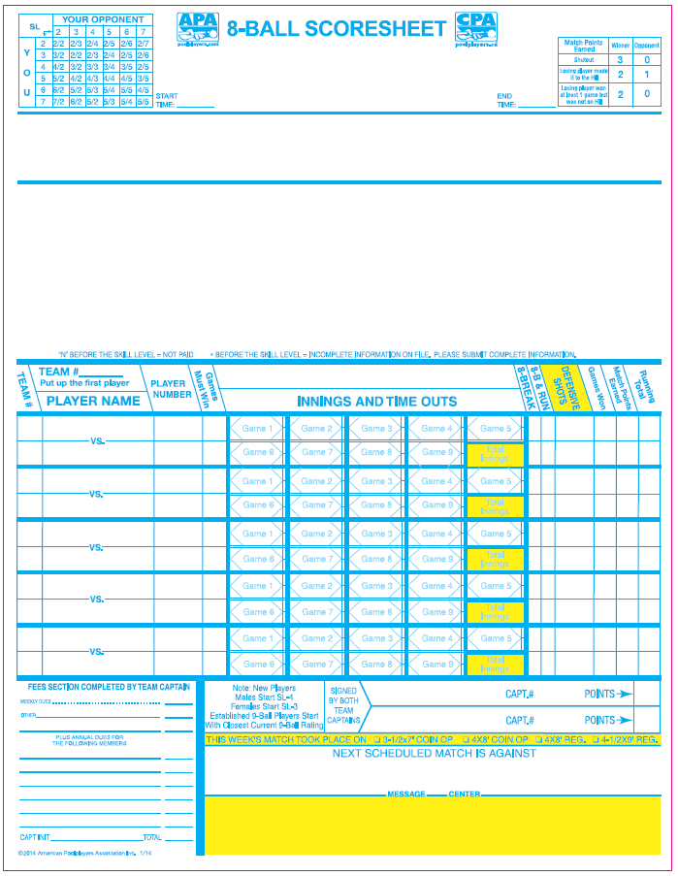
Traditional Scorekeeping
Team name and players typically goes here
Match 1
5 matches played by 10 different players
(5 from each team, 2 at a time)
Each comprised of games (ranging from 1 game minimum to 9 games maximum)
Match 2
Match 3
Match 4
Match 5

Slide 5

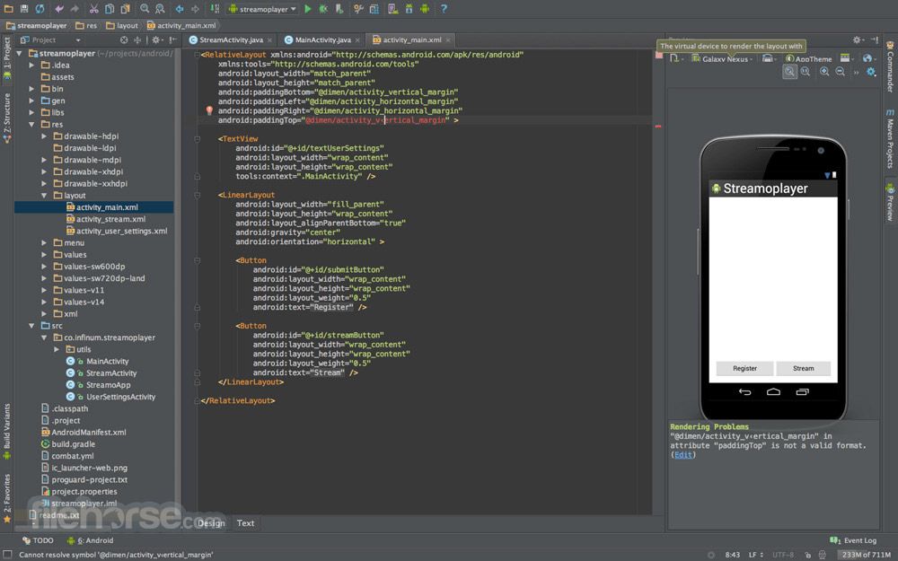

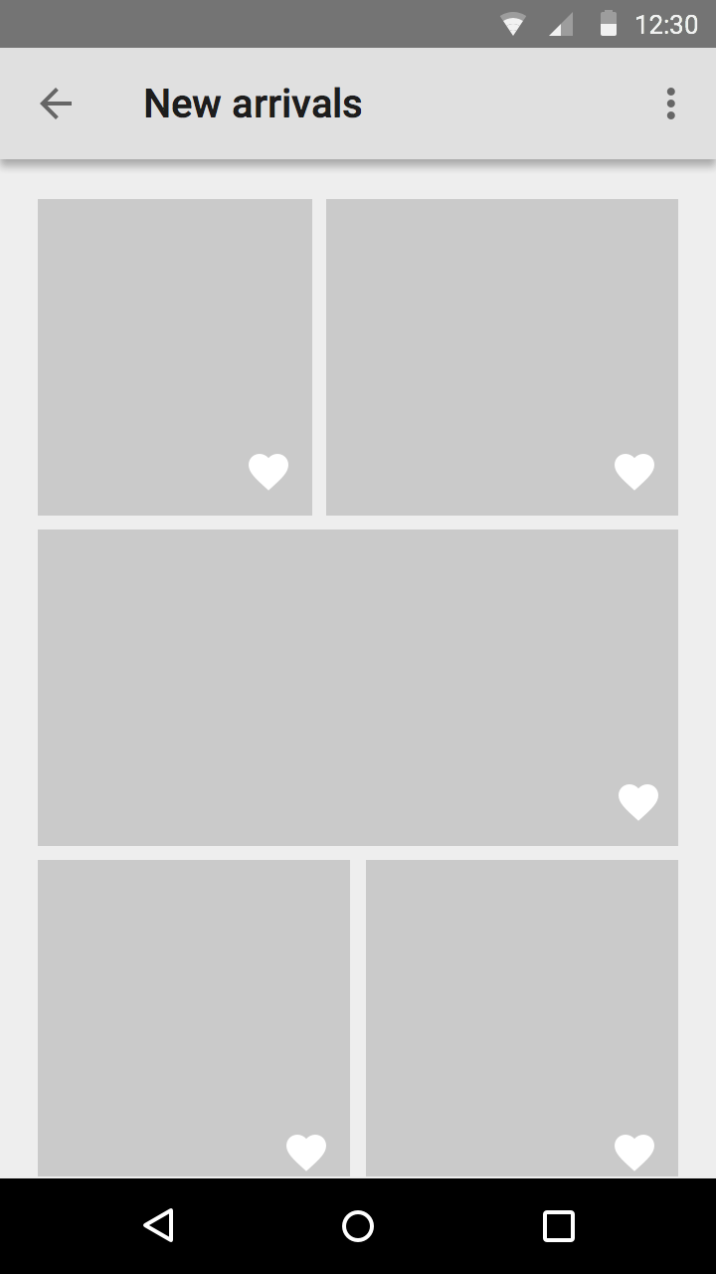
Technologies Used
Technologies used are…
Google Drive
Android Studio
FireBase
Adobe Illustrator
Draw.io/Umlet
Slack
GitHub
Android is the best!
Firebase is not!

Slide 6
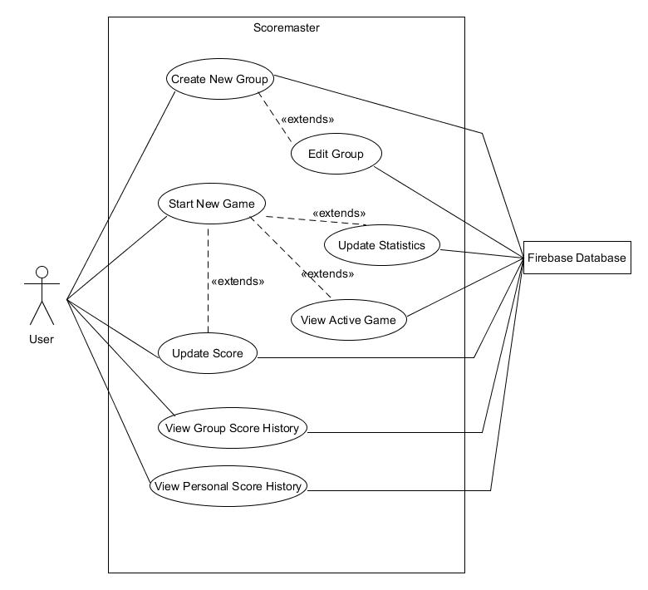
Use Case Diagram

Slide 7
Text Use Case
Use Case ID: SM801
Scenario: Start a new Group Game
Actor: User
Pre-Conditions:
1. User is logged in
2. User is part of a group with more than 1 member
Description:
User opens the app
User selects the “groups” option on main menu
System switches to Groups screen
User selects the group they wish to play with from drop down menu.
System fetches the group player list
User selects the players for the game and confirms
System logs a new game instance
System loads game scoring screen
Post Conditions:
A new game entry has been stored for the group.
Group statistic for games played increases by 1
Alternate Courses of Action:
In step D.5, if exactly 2 players are not selected, the system shall prompt the user to enter the correct number of players.
Exceptions:
System fails to retrieve group player list

Slide 8
“No Players” Test Case
Test Case ID: TSM801-01
Test Priority (Low/Medium/High): Med
Module Name: Groups
Test Title: GroupGameNoPlayers
Testing Tool:
Description: Attempt to start a group game with no players selected
Steps | Test Step | Test Data | Expected Result | Actual Result
1 | User opens Groups page | NA | Group page opens
2 | User selects group to play with | “Friday League” | Player list for “Friday League” is displayed
3 | User selects Start Game with no players selected | NA | Error message displayed

Slide 9
Personas
Frank Franklin | Age 18 Plays with whoever is at the hall Wants to track improvement
Smallie Biggs | Age 45 Never has a scoresheet available Doesn’t care about persistent tracking
Joe Johnson | Age 20 Plays pool/golf on occasion Plays for fun Wants a quick/convenient way to score both games
Moe Monroe | Age 30 Competitive pool player Wants to track personal stats to see who is the best
Bill Jackson | Age 54 Retired from military Not tech savvy Loves to play pool/darts/cards with friends
Josh Munster | Age 22 Plays on 3 teams IT enthusiast Also plays golf/bowling/darts/volleyball Tech savvy
Bob Smith | Age 55 Plays pool with friends New smartphone user Wants to keep track of his matches
Tammy Reed | Age 43 Plays in a league Wants a convenient way to score teams matches during league nights

Slide 10
Prototype Storyboard
Walkthrough

Slide 11
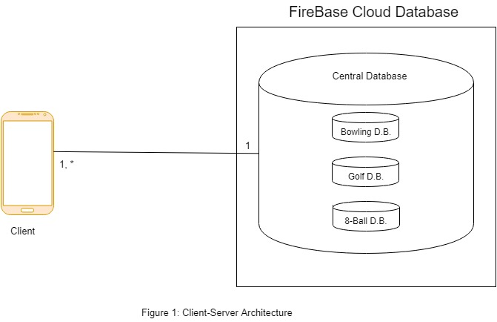
Architecture

Slide 12
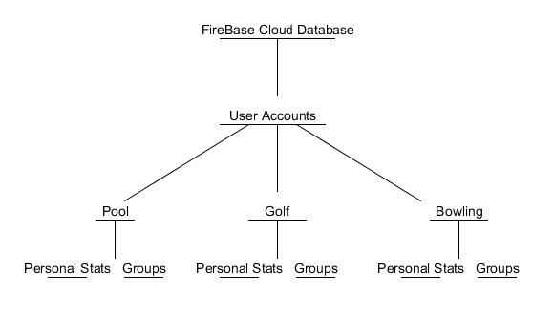
Persistent Data

Slide 13
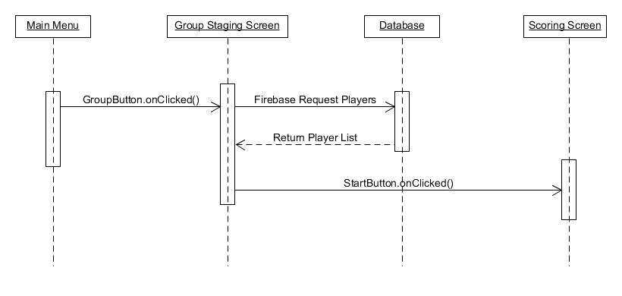
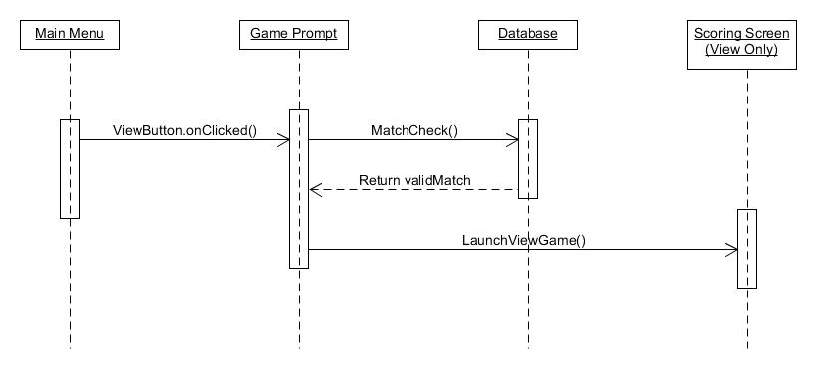
Sequence Diagrams
Sequence Diagram for “View Active Game”
Sequence Diagram for “Start a new Group Game”

Slide 14
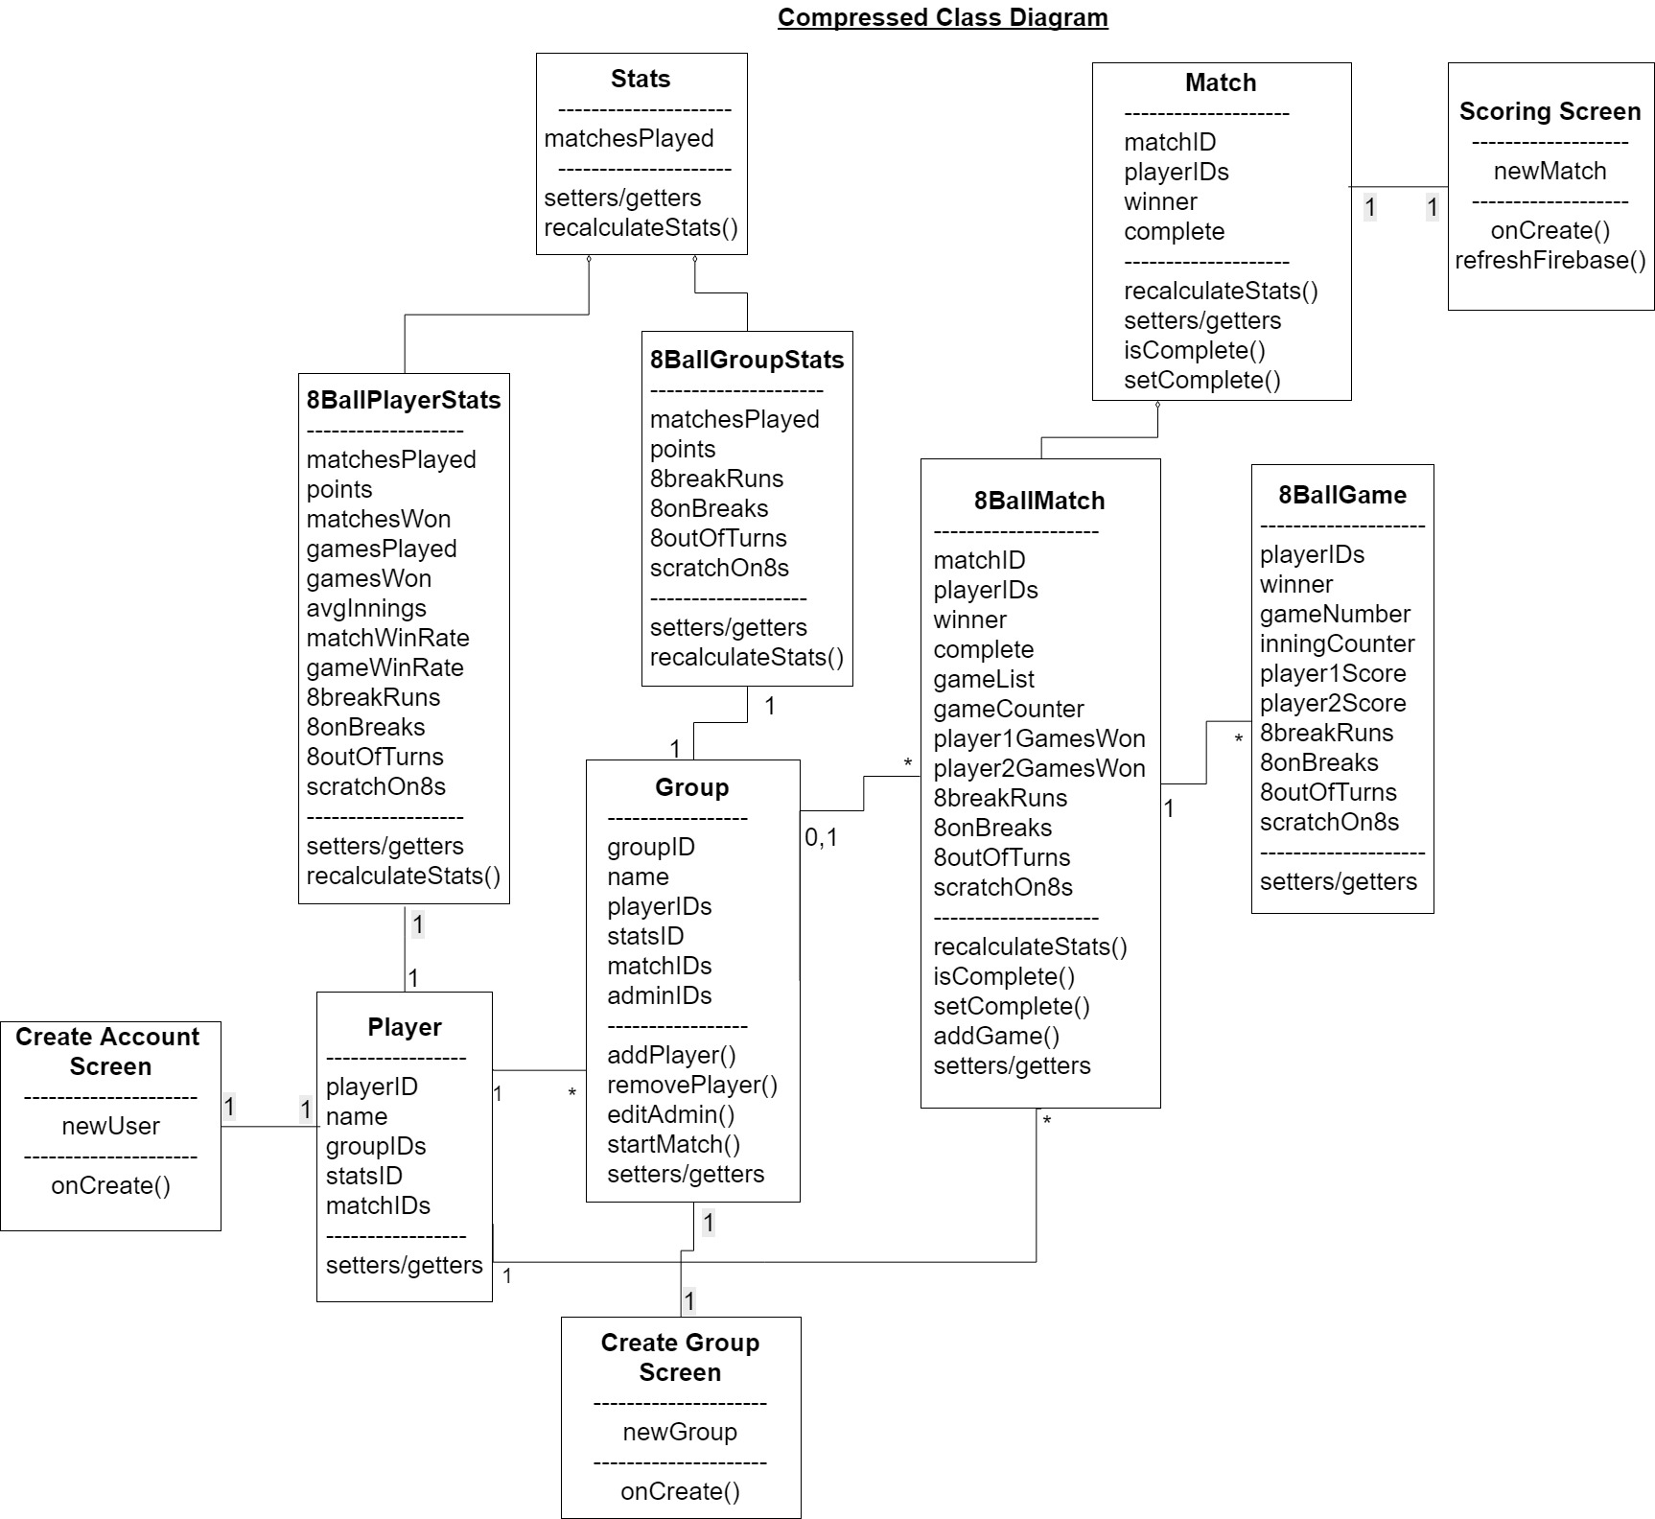
Class Diagram

Slide 15
Demo

Slide 16
Questions?

